Slide 1
Bingo game
Python project from scratch

Slide 2
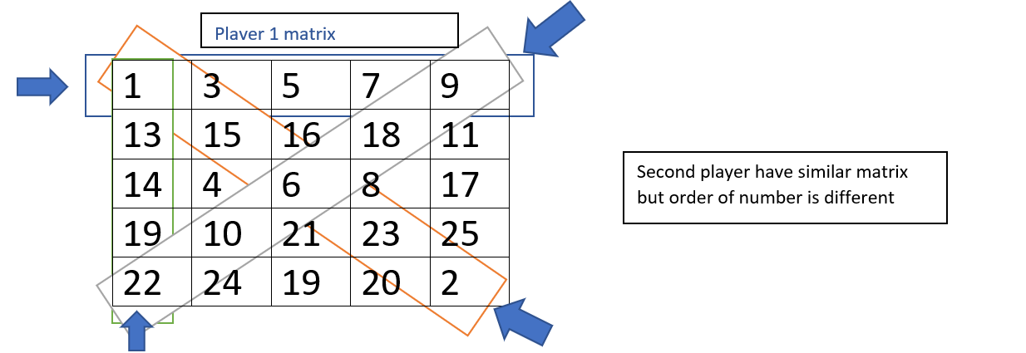
Background
Bingo game have 25 randomly numbered squares on them i.e. we have a 5x5 matrix with entries 1 to 25, our goal is to cover 5 of those squares in a vertical, horizontal, or diagonal row
there are two players and both have their matrices with entry between 1 and 25 (not repeated) . both players know only their matrix, not of the other. the number is same in both matrices but the position is different

Slide 3
introduction
We have created the same game with a modification that we can take a n x n matrix also we can cut m number of lines either horizontally vertical, diagonal and antidiagonal
After creating this game I found a strategy for winning that I put in code and also compare the result when we take different order matrices and define a rule for different no of line cuts then what happens if both players know the strategy if one player knows the strategy and if both players don’t know the strategy that I have concluded in result we have listed the result for 294 variant of the game also I have created next level game in which if we cut a row, column or diagonal then it is replaced by a new line with a random number and whoever cut the line score 1 is added in their score
In the play_rd function computer takes numbers randomly and in play function computer takes number from their strategy
For that game, we have created two different layouts which make the game more interesting

Slide 4
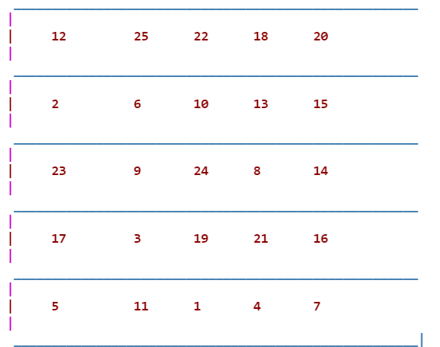
strategy
In the first turn, the system selects a number from a corner since it has a max chance of cutting a line since it contributes to cutting row columns as well as diagonal after playing by the second player he found which line has the maximum number of cutting points it may be diagonal, horizontal or vertical after finding that line computer find all non zero entry in that line and for that find max no of cutting point in corresponding row and column after that function gives output what no he want to cut

Slide 5
Result
In the code I have provided a matrix in which we have compared what happens when we take a matrix of order 5 x 5, 6 x 6, 7 x 7,8 x 8,9 x 9 10 x 10, and if we define a different rule like if we cut 5 6 7 8 9 10 number of lines to win the game
In that rule we conclude that if we take a greater number of lines and then the order of the matrix then the first player has more chance of winning since we have less choice of selecting the numbers like in a 5 x 5 matrix if we fix number of lines have to cut as 10 then at the end, we have to cut every entry of matrix and we have no choice of selecting the number in that case the first player always win the game
If we have more choice of selecting a number then we have more chance of winning like in 5x5 if we take 5,6 or 7 lines of cut for winning then our winning chance is high

Slide 6
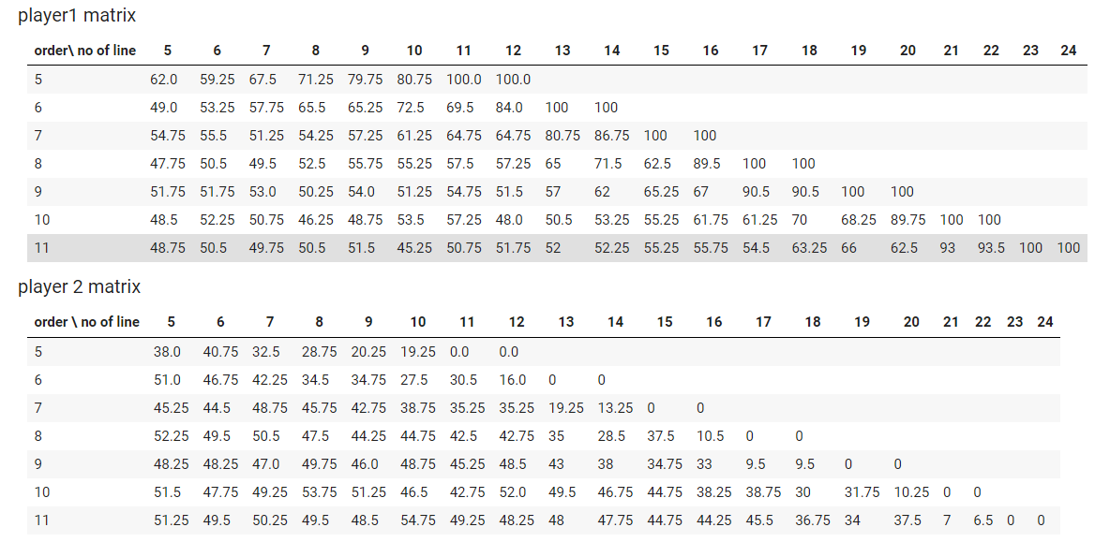
When both player know the strategy

Slide 7
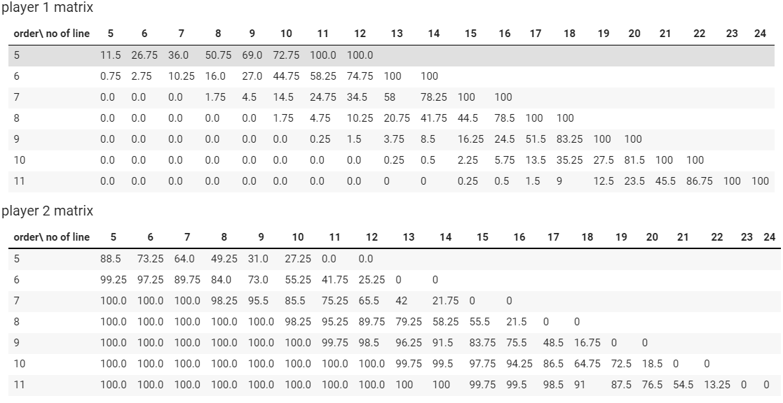
When one player know the strategy

Slide 8
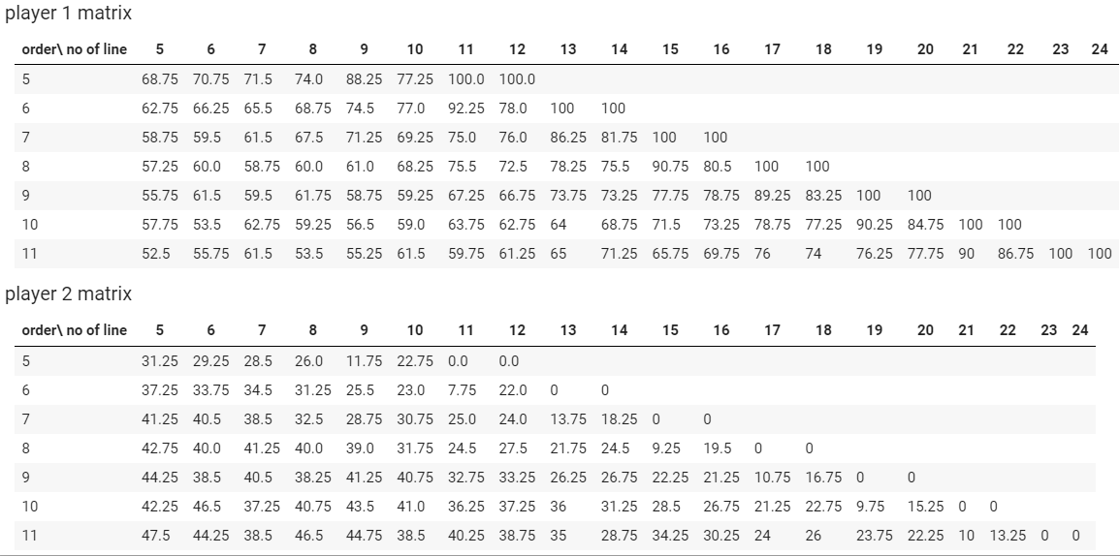
When both players play randomly

